Slide 1
Liberalism 1.0 Timbro 28 May 2019
By Daniel Klein
Notes:
I am thrilled and grateful for this opportunity. Thank you all.

Slide 2
A. Kahan 2003: Liberalism in Nineteenth Century Europe: The Political Culture of Limited Suffrage
B.D. Losurdo 2006: Liberalism: A Counter-History
G. Smith 2013: The System of Liberty: Themes in the History of Classical Liberalism
E. Fawcett 2014: Liberalism: The Life of an Idea
R. Adcock 2014: Liberalism and the Emergence of American Political Science
M. Freeden 2015: Liberalism: A Very Short Introduction
S. Nycander 2016: The History of Western Liberalism

Slide 3
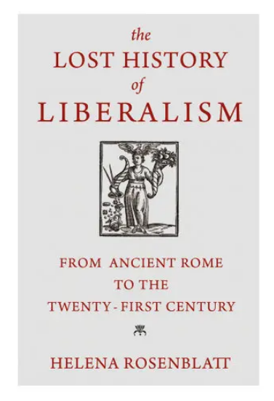

Slide 4
Big questions
What does politics mean to us?
What are we?
Where should the story begin?

Slide 5
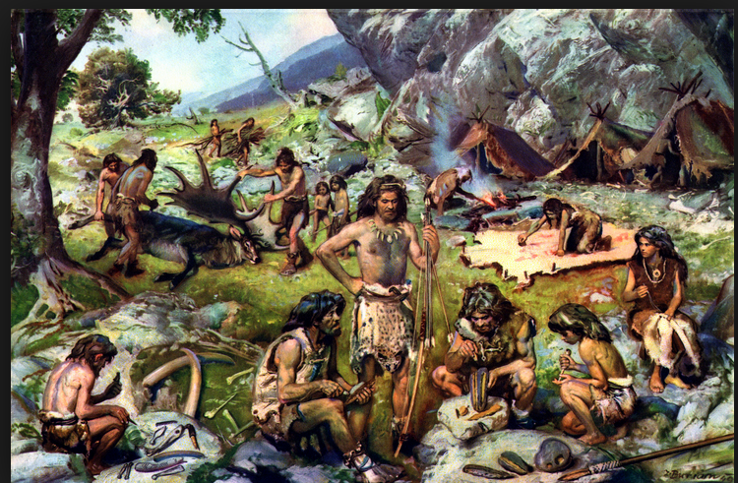
The ancestral band
10,000 BCE
Notes:
I think our genes and instincts are rooted in the ancestral band. Our brains were selected for a small, simple social world of strong cohesion. As a result we have strong tendencies toward cohesionism in politics, tendencies that don’t fit modern life, tendencies we need to rechannel and subdue.

Slide 6
1440 (the printing press)
The Emergence
1776 (WN, Decl. of Ind.)

Slide 7
What emerged?
What’s the story?
What was its name?

Slide 8
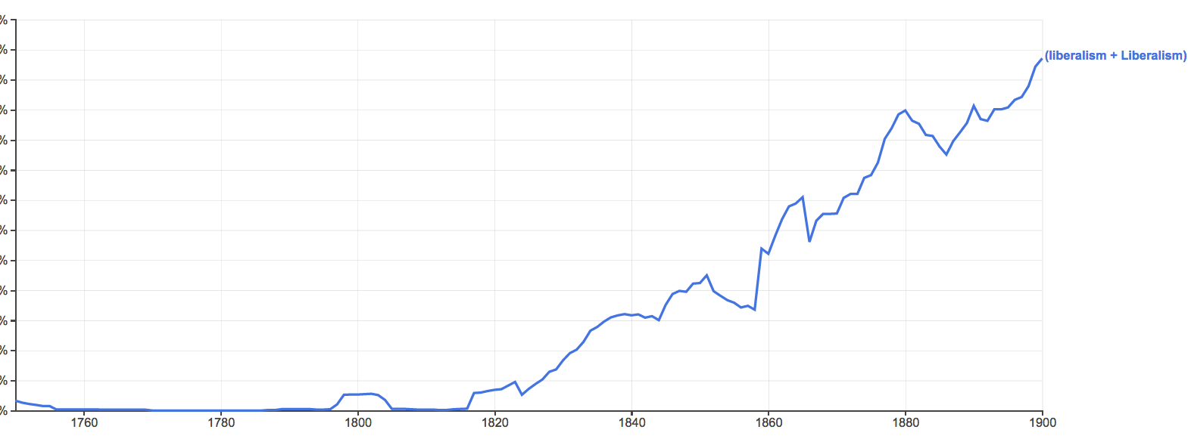
“liberalism”
1820

Slide 9
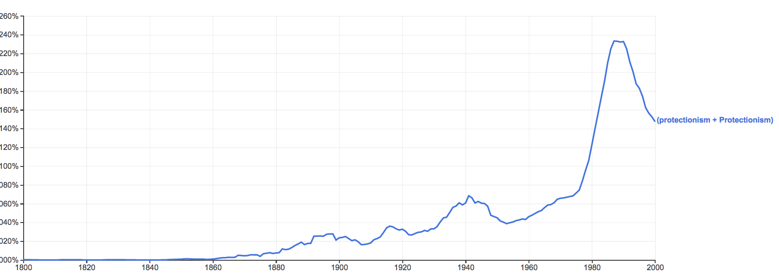
“protectionism”
1860

Slide 10
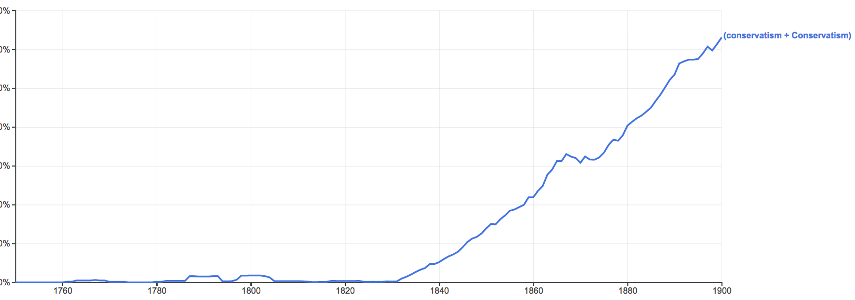
“conservatism”
1830

Slide 11
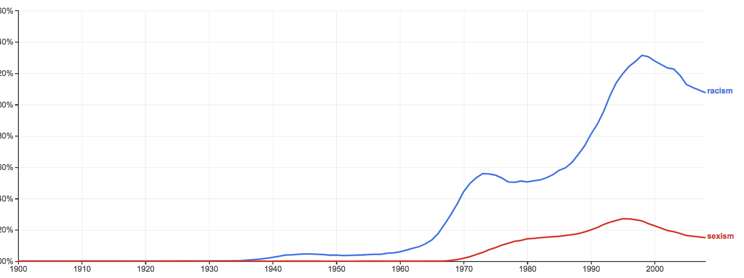
“racism,” “sexism”
1940

Slide 12
“liberalism”
1820

Slide 13
Two perspectives on inception of a political meaning

Slide 14
The importation thesis: That liberal-in-a-political-sense was imported into Britain from the Continent
Helena Rosenblatt – kinda, see, e.g., p. 42.
Jörn Leonhard
Daisy Hay (2008, 310, 312)
David M. Craig (2012, 469, 481ff)
R.R. Palmer and Joel Colton (1984, 428)
J. Salwyn Shapiro (1958, 9)
Auguste Nefftzer (implied, 1863)
James Fitzjames Stephens (1862)
An 1823 article (by R. Southey?) in the Tory journal Blackwood’s

Slide 15
Hayek thesis
“It is often suggested that the term “liberal” derives from the early nineteenth-century Spanish party of the liberales. I am more inclined to believe that it derives from the use of the term by Adam Smith in such passages as W.o.N., II, 41: “the liberal system of free exportation and free importation” and p. 216: “allowing every man to pursue his own interest his own way, upon the liberal plan of equality, liberty, and justice.” (Hayek 1960, 530 n13)

Slide 16
What emerged? How did it emerge?
Traditional society 1440.
And then:
Printing press. Disjointed interpretation.
Reformation, Wars of religion, Westphalia 1648
Toleration, rise of nation-state, print culture, “the public,” “the people.”
Inversion of government’s focus. Natural jurisprudence.
TMS & 1776 WN: “the liberal plan”, “the liberal system”

Slide 17
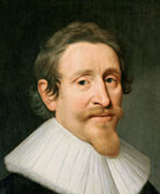
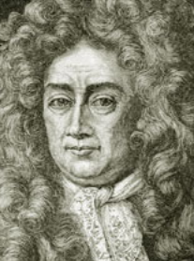
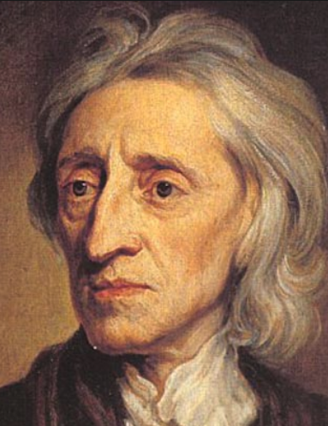
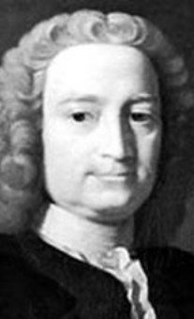
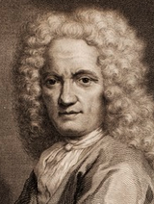
Samuel Pufendorf
Hugo Grotius
John Locke
Natural jurisprudence,
Political theory
Francis Hutcheson
Also:
Gershom Carmichael
Jean Barbeyrac
Notes:
These are some of the men who said: “Back off of the higher things!”

Slide 18
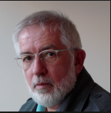
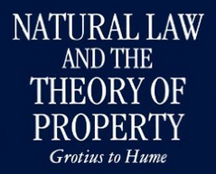
Stephen Buckle
Also:
Duncan Forbes
Knud Haakonssen
etc.
Notes:
But still there is strong continuity from them to Hume and Smith., as Stephen Buckle, for example, shows.

Slide 19
Some genealogy of liberalism 1.0
“proto-liberals”
→ Political stability in Britain
Grotius-Locke-Hume
Hume-Smith
“liberal” as the name
1600 1689 1776 …. Gladstone….
We extend “liberal” backward in time, before 1776
Notes:
Grotius-Locke-Hume are a tradition…
We extend “liberal” back before 1776.
“proto-liberals”

Slide 20
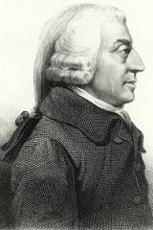
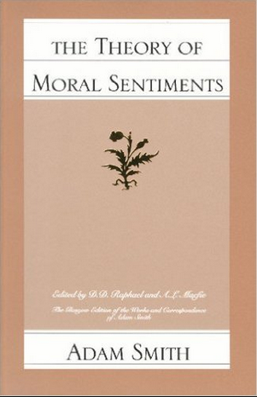
Adam Smith 1723-1790
Treats virtues
you are to practice

Slide 21
Commutative justice
“The most sacred laws of justice…are the laws which guard the life and person of our neighbour; the next are those which guard his property and possessions; and last of all come those which guard what are called his personal rights, or what is due to him from the promises of others.”
Notes:
Commutative justice a one of those virtues you are to practice…

Slide 22
Adam Smith
Commutative justice:
Not messing with
other people’s
stuff
Understood within historical context.
Uniformity amidst variety.
Notes:
…
General formulation but…
Uniformity amidst diversity.
Government law affects fine points but does not undo natural conventions

Slide 23
Flipside of CJ
Flipside: Others not messing with your stuff
In E-E: “security”
In S-i: “liberty,” “natural liberty.”
“Both laws were evident violations of natural liberty, and therefore unjust” (WN, 530.16)

Slide 24
Smith, WN
The spine of liberalism 1.0 is CJ/liberty.
WN morally authorizes pursuit of honest income and a presumption of liberty.

Slide 25
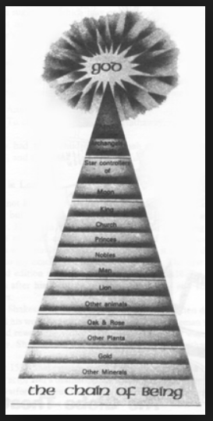
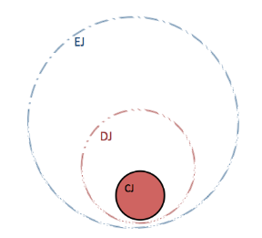
“…and the pursuit of happiness”
“life, liberty,”
Notes:
“life, liberty, and the pursuit of happiness”

Slide 26
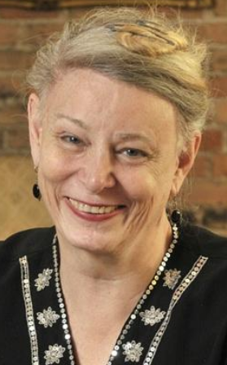
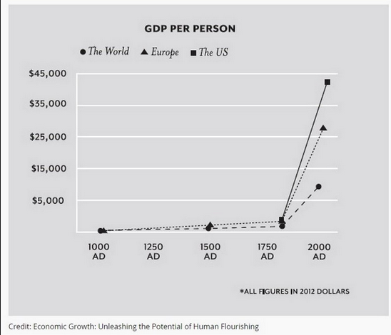
The Great Enrichment
Deirdre McCloskey

Slide 27
That’s what emerged.
About its name…

Slide 28
Samuel Johnson 1755
liberal arts, liberal sciences, liberal professions

Slide 29
But suddenly…
The word liberal was put to use in a quite particular political way.

Slide 30
William Robertson
(1721-1793)
History of the Reign of the Emperor Charles V, with a View of the Progress of Society in Europe (1769, 4 vols)

Slide 31
William Robertson
The Scottish historian and Principal of the University of Edinburgh, and leader in the Church of Scotland.
Some examples:
1769, The History of the Reign of the Emperor Charles V, Volume 1:
“The revival of the knowledge and study of the Roman law, co-operated with the causes which I have mentioned, in introducing more just and liberal ideas concerning the nature of government, and the administration of justice.”
“Every little community subsisting on its own domestick stock, and satisfied with it, is either unacquainted with the states around it, or at variance with them. Society and manners must be considerably improved, and many provisions must be made for public order and personal security, before a liberal intercourse can take place between different nations.”

Slide 32
William Robertson
“When the manners of the European nations became more gentle, and their ideas more liberal, slaves who married without their master's consent, were subjected only to a fine.”
“...but the ideas are singular, and much more liberal and enlarged than one could expect in that age. A popular monarch of Great Britain could hardly address himself to parliament, in terms more favourable to publick liberty. There occurs in the History of France a striking instance of the progress which the principles of liberty had made in that kingdom, and of the influence which the deputies of towns had acquired in the States General.”
“That may have been the case, but these men possessed the confidence of the people ; and the measures which they proposed as the most popular and acceptable, plainly prove that the spirit of liberty had spread wonderfully, and that the ideas which then prevailed in France concerning government were extremely liberal.”

Slide 33
William Robertson
“...the spirit and zeal with which they contended for those liberties and rights without which it is impossible to carry on commerce to advantage. The vigorous efforts of a society of merchants attentive only to commercial objects, could not fail of diffusing over Europe new and more liberal ideas concerning justice and order whereever they settled.”
“The Aragonese were no less solicitous to secure the personal rights of individuals, than to maintain the freedom of the constitution ; and the spirit of their statutes with respect to both was equally liberal.”
From a 1776 letter to Smith:
“You have formed into a regular and consistent system one of the most intricate and important parts of political science, and if the English be capable of extending their ideas beyond the narrow and illiberal arrangements introduced by the mercantile supporters of Revolution principles, and countenanced by Locke and some of their favourite writers, I should think your Book will occasion a total change in several important articles both in police and finance. ...many of your observations concerning the Colonies are of capital importance to me. I shall often follow you as my Guide and instructor.”

Slide 34
William Robertson
A year later in 1777, Robertson published his History of the Discovery and Settlement of America, in which he wrote:
"What may be the effects of opening this communication between countries destined by their situation for reciprocal intercourse cannot yet be determined by experience. They can hardly fail of being beneficial and extensive. The motives for granting this permission are manifestly no less laudable than the principle on which it is founded is liberal; and both discover the progress of a spirit in Spain, far elevated above the narrow prejudices and maxims on which her system for regulating the trade and conducting the government of her colonies was originally founded. ...The nation has adopted more liberal ideas, not only with respect to commerce, but domestic policy."

Slide 35
Smith letter to Cullen 1774
“That in every profession the fortune of every individual should depend as much as possible upon his merit, and as little as possible upon his privilege, is certainly for the interest of the public. It is even for the interest of every particular profession, which can never so effectually support the general merit and real honour of the greater part of those who exercise it, as by resting on such liberal principles.”

Slide 36
Smith, WN
Establishes “liberal” as signifier
→ liberalism

Slide 37
Smith WN passages
“[Colbert] had unfortunately embraced all the prejudices of the mercantile system, in its nature a system of restraint and regulation…The industry and commerce of a great country he endeavoured to regulate upon the same model as the departments of a publick office; and instead of allowing every man to pursue his own interest his own way, upon the liberal plan of equality, liberty and justice, he bestowed upon certain branches of industry extraordinary privileges, while he laid others under as extraordinary restraints.” (664-5)

Slide 38
Smith WN passages:
“Were all nations to follow the liberal system of free exportation and free importation, the different states into which a great continent was divided would so far resemble the different provinces of a great empire. As among the different provinces of a great empire the freedom of the inland trade appears, both from reason and experience, not only the best palliative of a dearth, but the most effectual preventative of a famine; so would the freedom of the exportation and importation trade be among the different states into which a great continent was divided. The larger the continent, the easier the communication through all the different parts of it, both by land and by water, the less would any one particular part of it ever be exposed to either of these calamities, the scarcity of any one country being more likely to be relieved by the plenty of some other. But very few countries have entirely adopted this liberal system.”

Slide 39
Smith WN passages
“But though the policy of Great Britain with regard to the trade of her colonies has been dictated by the same mercantile spirit as that of other nations, it has, however, upon the whole, been less illiberal and oppressive than that of any of them.”
“In the different ways in which this monopoly has been exercised, consists one of the most essential differences in the policy of the different European nations with regard to their colonies. The best of them all, that of England, is only somewhat less illiberal and oppressive than that of any of the rest.”

Slide 40
Smith WN passages
On the system of the Physiocrats: “According to this liberal and generous system, therefore, the most advantageous method in which a landed nation can raise up artificers, manufacturers and merchants of its own, is to grant the most perfect freedom of trade to the artificers, manufacturers and merchants of all other nations.”

Slide 41
Smith WN passages
“...in representing the wealth of nations as consisting, not in the unconsumable riches of money, but in the consumable goods annually reproduced by the labour of the society; and in representing perfect liberty as the only effectual expedient for rendering this annual reproduction the greatest possible, its doctrine seems to be in every respect as just as it is generous and liberal.”

Slide 42
Smith WN passages
“… [T]he principal attributes of villanage and slavery being thus taken away from them [that is, the burghers/townspeople living in the towns treated by the sovereign as Smith describes] they now, at least, became really free in our present sense of the word Freedom … [I]n this manner [the sovereigns of all the different countries of Europe] voluntarily erected a sort of independent republicks in the heart of their own dominions. … The princes who lived upon the worst terms with their barons, seem accordingly to have been the most liberal in grants of this kind to their burghs.” (400-402)

Slide 43
Correspondence 1776
fr. W. Robertson:
“beyond the narrow and illiberal arrangements” (153)
fr. J. Black:
“a comprehensive System composed with such just and liberal sentiments.” (151)

Slide 44
How do we really know?

Slide 45
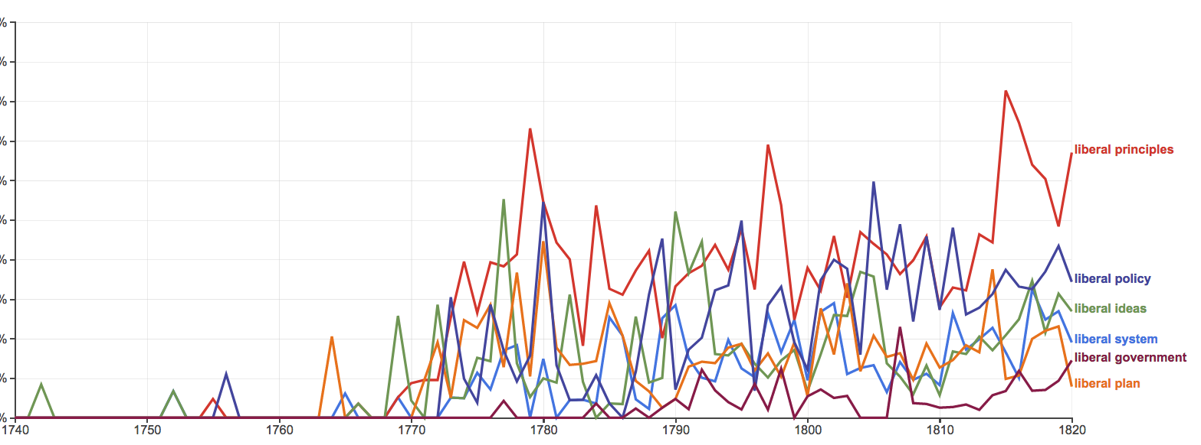
liberal burgeoning: principles, policy, ideas, system, government, plan
1770
1820

Slide 46
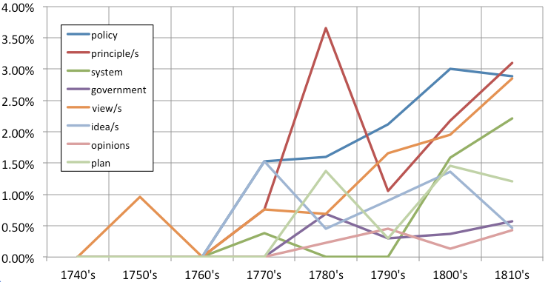
% of political collocating nouns out of top 100 collocating nouns, by decade

Slide 47
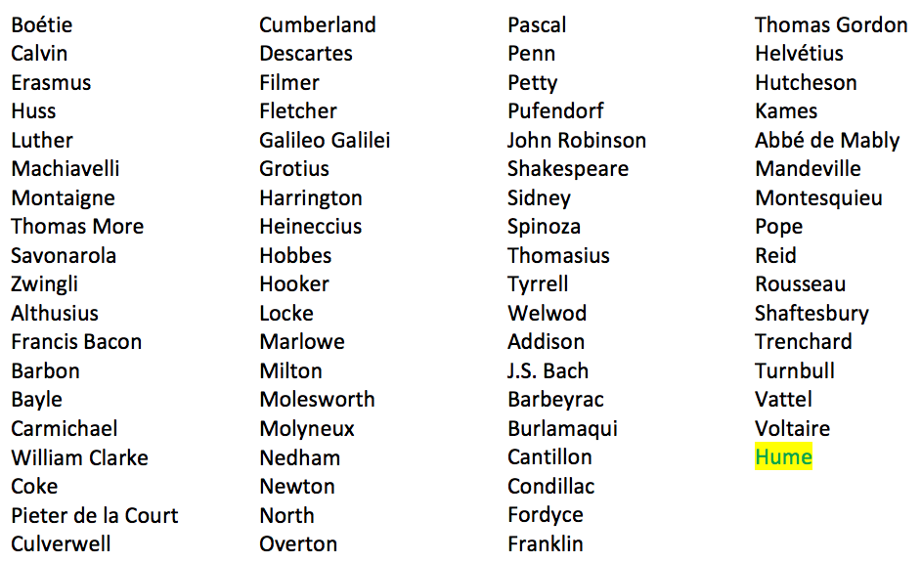
1769 is the start: Confirmed. Searched all of the works at LF site by

Slide 48
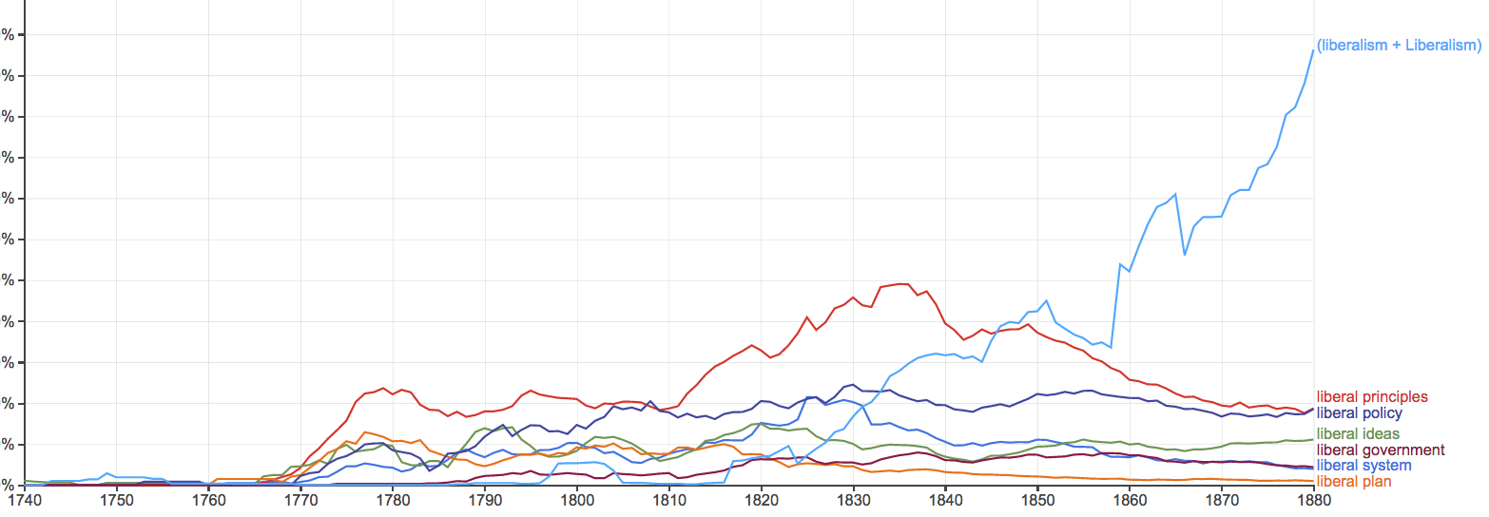
(“liberalism” + “Liberalism”)
1770
1820
1880

Slide 49
“liberal” in British officialdom
King George III’s Speech opening 3rd session of Parliament in 1782: “The liberal principles …”
Study of: Parliamentary History of England … to the Year 1803

Slide 50
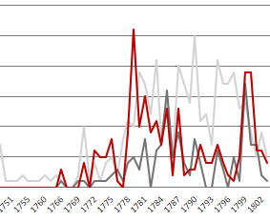
“liberal” in British parliamentary debate
Spikes after WN
1770
1802

Slide 51
Dugald Stewart
(1753-1828)
“At Edinburgh he lectured on the principles of government and political economy in 1800–8 to an influential group of students who were to do much to form Whig and Tory opinion in the early 19th century.” (Phillipson in New Palgrave)

Slide 52
In Stewart’s “Account” of Smith
“those liberal views of commercial policy”
“the liberal policy of modern times”
“Such are the liberal principles”
“his liberal system”
“Some of these liberal principles found their way into France”

Slide 53
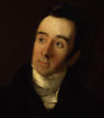
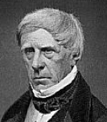
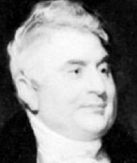
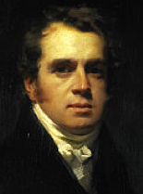
Started in 1802. Supported Whig party and liberal politics.
Dugald Stewart “exercised the dominant influence on the reviewers” (Fontana, 4)
Editor 1802-1829
Francis Jeffrey
1773-1850
Henry Brougham
1778-1868
Sydney Smith
1771-1845
Francis Horner
1778-1817

Slide 54
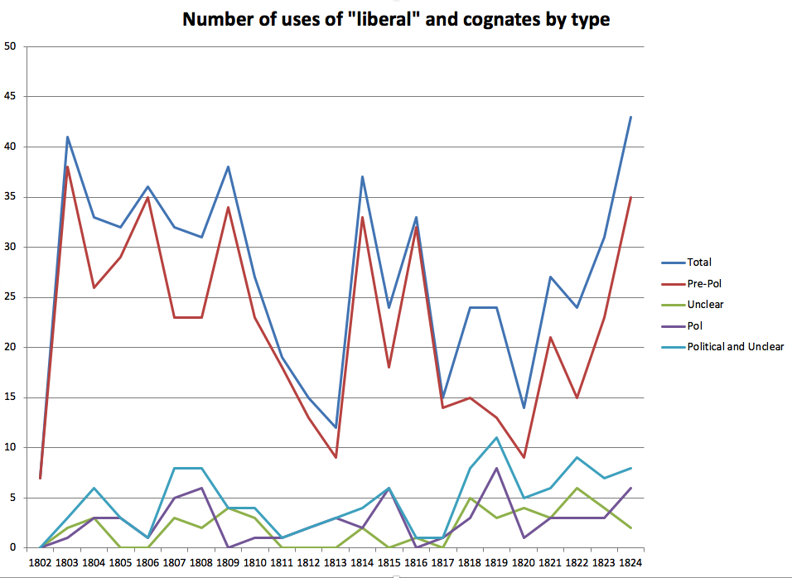
1802
1824

Slide 55
John Ramsay McCulloch (1789-1864)
Another Scot
“arguably the first professional economist” (source)
“Political Economy” entry in 1824 Encyclopedia Britannica + his 1824 Disc., 1825 Princ.s, 1821 ER article,.
“liberal” ~ 12 times
Reprinted in US in 1825.

Slide 56
Smith is about liberal policy reform
Dugald Stewart:
“The progress already made in [political economy]…has been sufficient to shew, that the happiness of mankind depends, not on the share which the people possess, directly or indirectly, in the enactment of laws, but on the equity and expediency of the laws that are enacted.”
“[T]he most celebrated works … by Smith, Quesnai, Turgot, Campomanes, Beccaria, and others, have aimed at the improvement of society,--not by delineating plans of new constitutions, but by enlightening the policy of actual legislators.”
(EPS 310, 311)

Slide 57
WN: “the liberal plan”
Presupposes an integrated and stable polity.

Slide 58
Stable polity in Britain, “adamantine” by 1725
Notes:
Not long after the Glorious Revolution, Britain attained robust political stability. Our next heroes, Hume and Smith, lived in and wrote for such a world, presupposing a stable polity. That is one reason why we find it much easier to understand Hume and Smith than to understand the 17th century writers.

Slide 59
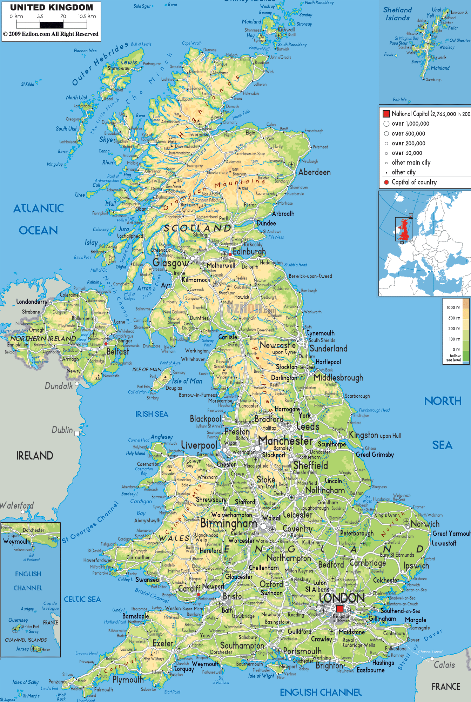
The island nation-state
Liberalism 1.0:
Aspiration of liberal polity
Notes:
The British experience is central. We should come to terms with that.

Slide 60
Liberal polity
That aspiration requires a polity.
An integrated, functional, stable nation-state.

Slide 61
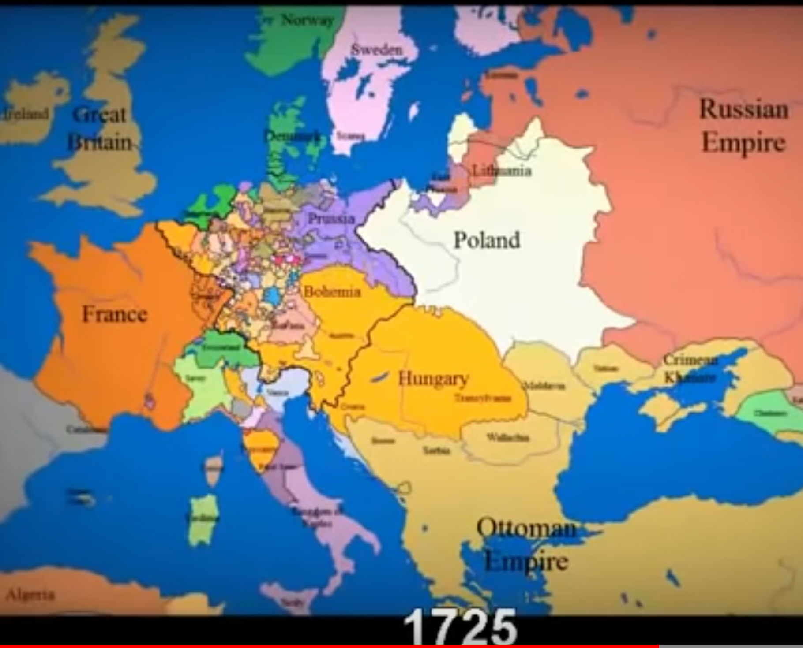
YouTube: timelapse map over 1000 years

Slide 62
Helena notes:
Liberals worry about the power of the state.
“German liberals, however, did not have a state.” (Rosenblatt p. 184)

Slide 63
A distinction:
Policy reform
Polity reformation

Slide 64
On the Continent: Perpetual crisis
Continental liberals beset with polity reformation.
Conquests, wars
Boundary/border disputes
Ethnic and religious conflict
Empires
Constitutional change (govt form, procedure, the electorate)
Revolutions, secessions
Church-state issues

Slide 65
On the Continent
Beset with polity reformation, liberals impelled to throw in with
the lesser evil.

Slide 66
Britain
Tocqueville: “In England writers on the theory of government and those who actually governed co-operated with each other, the former setting forth their new theories, the latter amending or circumscribing these in the light of practical experience. In France, however, precept and practice were kept quit distinct and remained in the hands of two quite independent groups. One of these carried on the actual administration while the other set forth the abstract principles on which good government should, they said, be based; one took the routine measures appropriate to the needs of the moment, the other propounded general laws without a thought for their practical application; one group shaped the course of public affairs, the other that of public opinion.”
Notes:
The British experience is central. We should come to terms with that.

Slide 67
Early translations (full or abridged)
Robertson’s Charles V:
French: 1771
German: 1770-71
Smith’s WN (Lai 404ff):
French: 1778/79, 1779/81, 1790, 1802
Spanish: 1792*, 1794
Italian: 1790/91
German: 1776/78/92, 1794/95/96
Swedish: Parts 1799-1801
Danish: 1779/1780

Slide 68
liberal burgeoning: principles, policy, ideas, system, government, plan
1770
1820

Slide 69
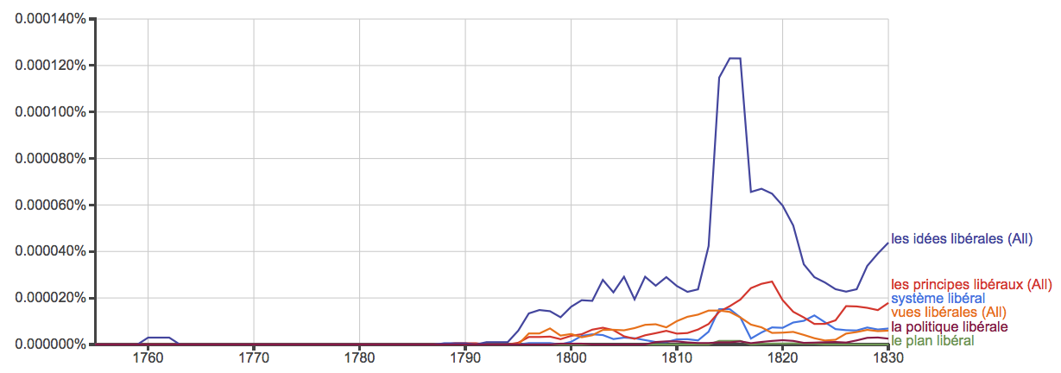
France
1770
1800

Slide 70
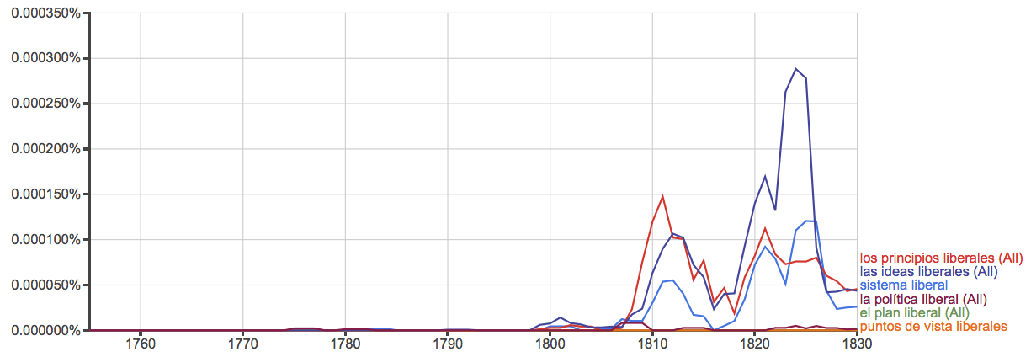
Spain
1770
1800

Slide 71
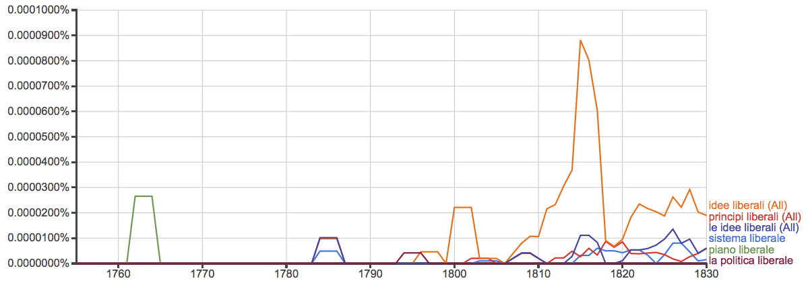
Italy
1770
1800

Slide 72
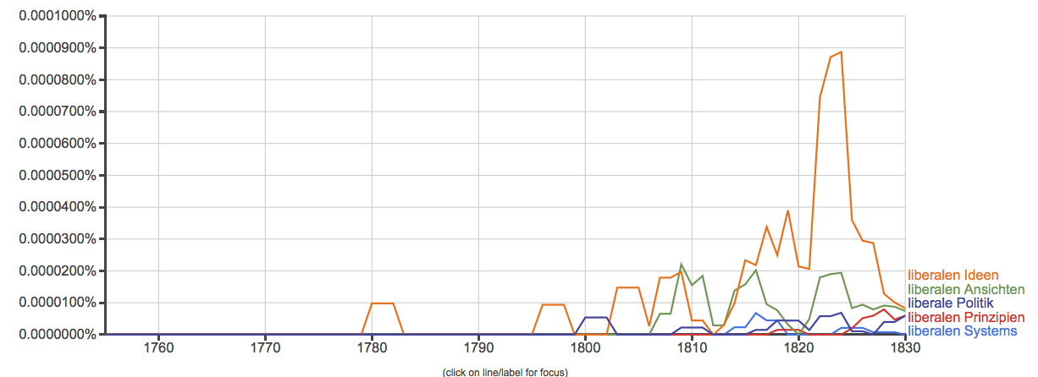
Germany
1770
1800

Slide 73
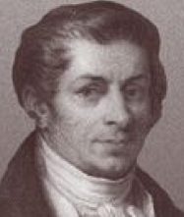
France
Early translations of Charles V and WN.
Smith in France 1764-66, friends in France.
David Hume in France 1734-37, 1763-66.
The French engaged Smith.
Jean-Baptiste Say (1767-1832)
“From 1794 to 1800 Say edited a periodical entitled La Decade philosophique, litteraire, et politique, in which he expounded the doctrines of Adam Smith. … In 1803 appeared Say's principal work, the Traité d'économie politique …” (Wikipedia)

Slide 74
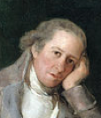
Spain
Jovellanos painted by Goya
Gaspar Melchor de Jovellanos (1744-1811)
Lawyer, author, statesman
“Though Jovellanos’ liberalism was not the product of a single influence, Smith impressed him profoundly.” (R.S. Smith in Lai p. 315)
Read WN four times.
By 1781 read and admired Charles V.
He was a leader of the Liberales!

Slide 75
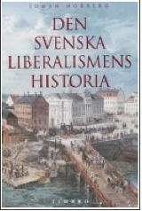
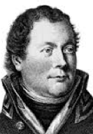
Sweden
Georg Adlersparre:
Highly Smithian
Translated parts of WN
Called himself “liberal” in 1804.
Led the ousting of the king and Liberal wing of the 1809-1810 constitutional convention!
Georg Adlersparre
1760-1835

Slide 76
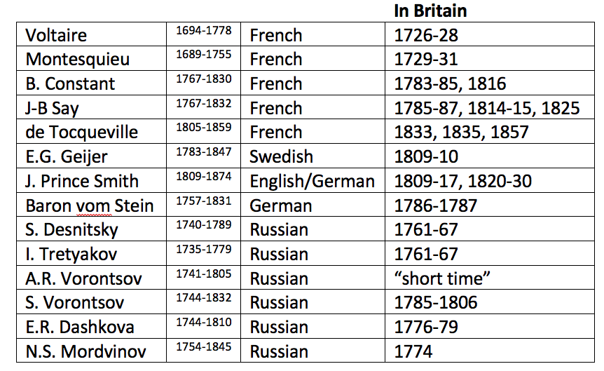
Liberal sojourns in Britain
Notes:
After 1880, liberalism declined quite suddenly.

Slide 77
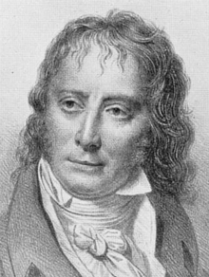
Liberals like Constant
Liberal because they favored liberalism 1.0 in policy reform.
But beset by polity reformation.
Did politics with aspiration of liberalism 1.0.

Slide 78
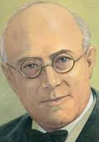
After 1880, Liberalism declined quite suddenly
Many said it declined because it failed.
Other explanations … I can’t go into...
Notes:
After 1880, liberalism declined quite suddenly.

Slide 79
The mentality of governmentalization
1880
1980
Notes:
Social thought shifted dramatically, toward the governmentalization of social affairs, as reflected in the ngrams of these phrases.

Slide 80
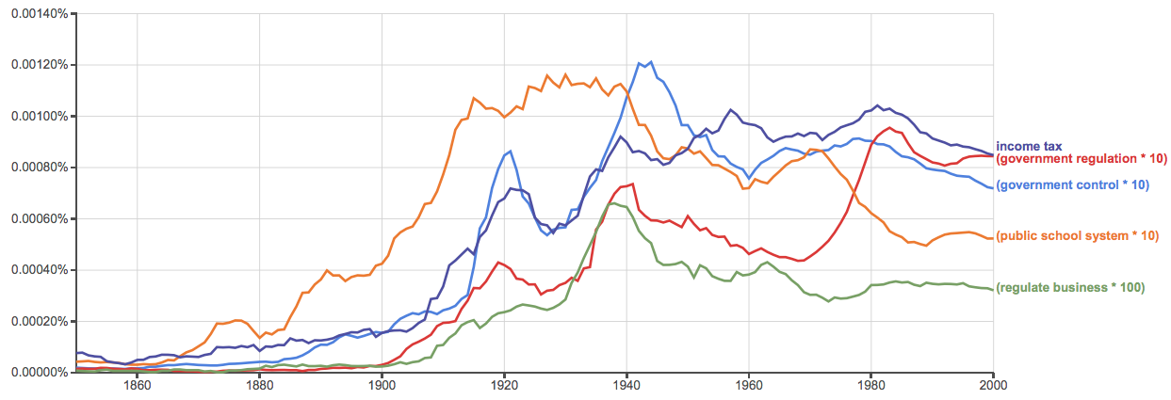
Government institutions
1880
1980
Notes:
And governmentalization rapidly advanced, and kept on advancing.

Slide 81
Words changed or lost meaning
liberal
liberty
freedom
rights
justice
property
contract
equality, equity
law, rule of law
Notes:
The central terms of liberal civilization changed or lost meaning, notable the word “liberal” itself.

Slide 82
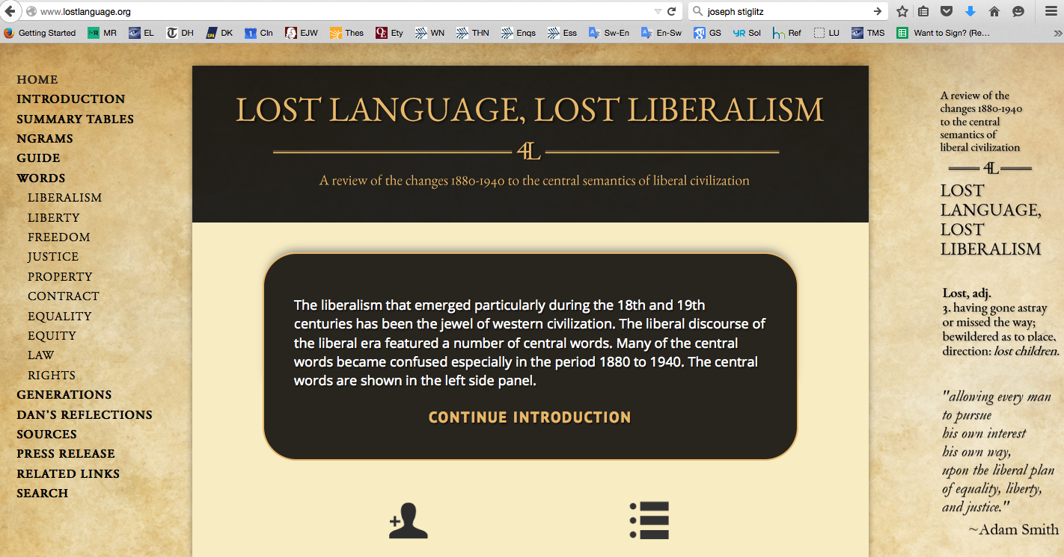
Notes:
At this website Ryan Daza and I have created compedia of quotations showing the semantic changes and the reactions to the changes.

Slide 83
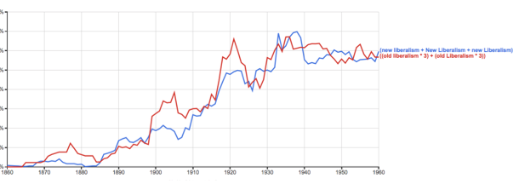
“new liberalism” “old liberalism”
1880
Notes:
“Liberal” changed or lost meaning. In fact, people spoke of a “new liberalism”, and others had to resort to speaking of “old liberalism.”

Slide 84
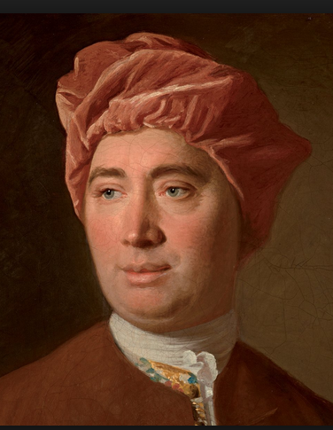
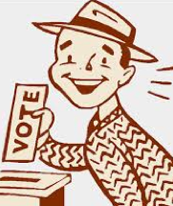
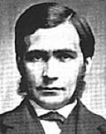
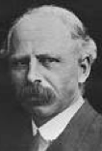
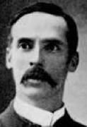
Three faces of “liberal”
Liberalism 1.0: The presumption of liberty
Democratism (see Wolin p. 263)
The governmentalization of social affairs
T.H. Green L.T. Hobhouse J.A. Hobson J. Dewey J. Stiglitz
Notes:
It is useful to think of three faces of liberalism…

Slide 85
Summary: Liberalism 1.0
A modern emergence, related to natural jurisprudence.
Maintained a presumption of “allowing every man to pursue his own interest his own way,” presupposing an integrated stable polity.
Best understood as a policy-reform outlook.
Paramount figure: Adam Smith.
Declined from about 1880.
Language subversion followed.
Today called classical liberalism.

Slide 86
Thank you for your attention!

